Slide 1
Battleship Tutorial
Click to Start

Slide 2
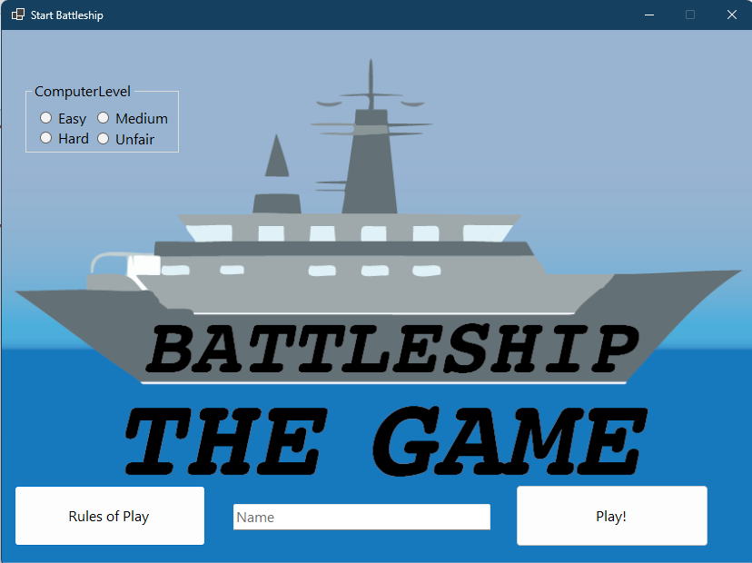
Welcome to Battleship!
This tutorial will explain how to play the game.
When you are ready, click the battleship to start.

Slide 3
Let’s start by choosing the computer difficulty. We will start with the Easy Difficulty.
Click it.

Slide 4
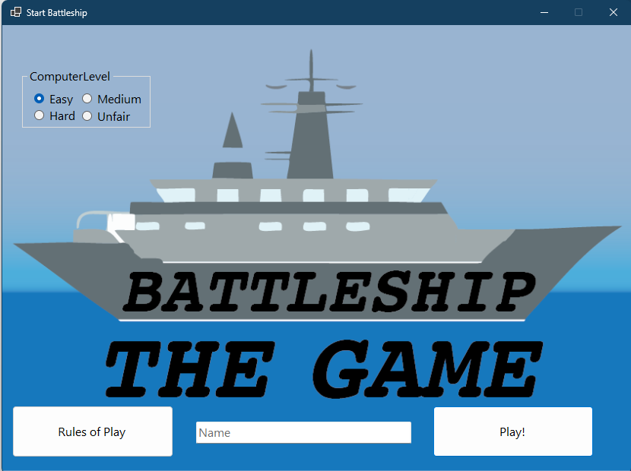
Nice!
Now let’s enter a name. Click on the text field. We will enter a name for you.

Slide 5
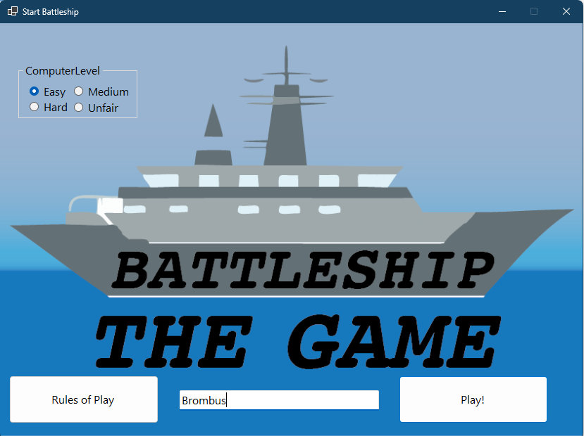
We are ready to play now. When you are ready to go, click Play!

Slide 6
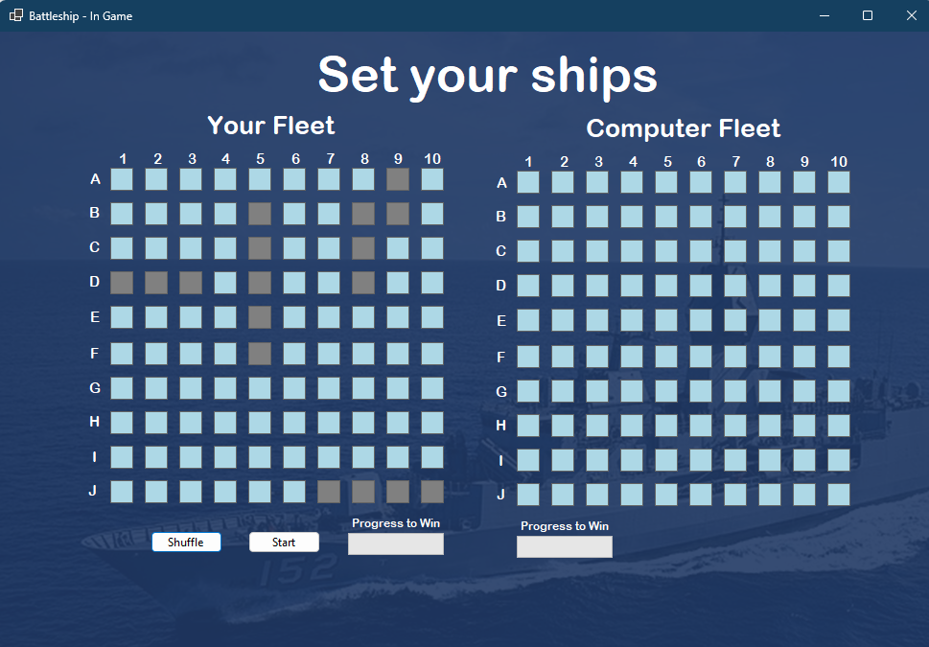
Before we start, we need to set our ships on our grid.
This arrangement doesn’t look too good. Let’s shuffle it.
Click Shuffle.

Slide 7
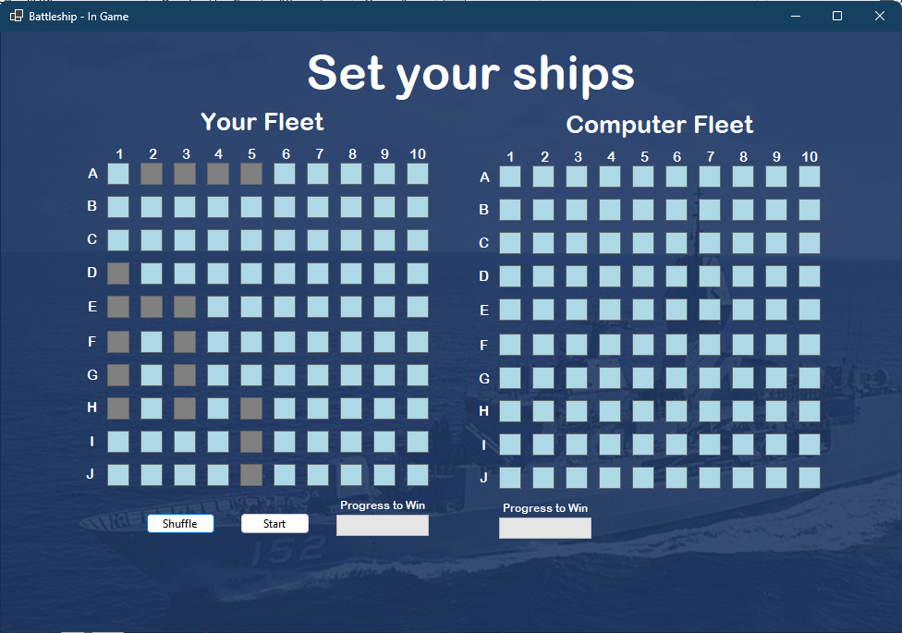
This looks better. The crowded ships will be difficult to guess.
We are ready to start the game now.
Click Start.

Slide 9
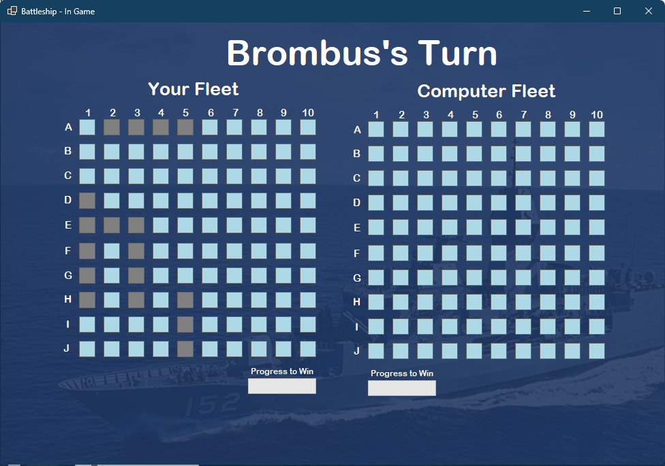
It’s time for our first move!
Click on E5 to make a guess.

Slide 10
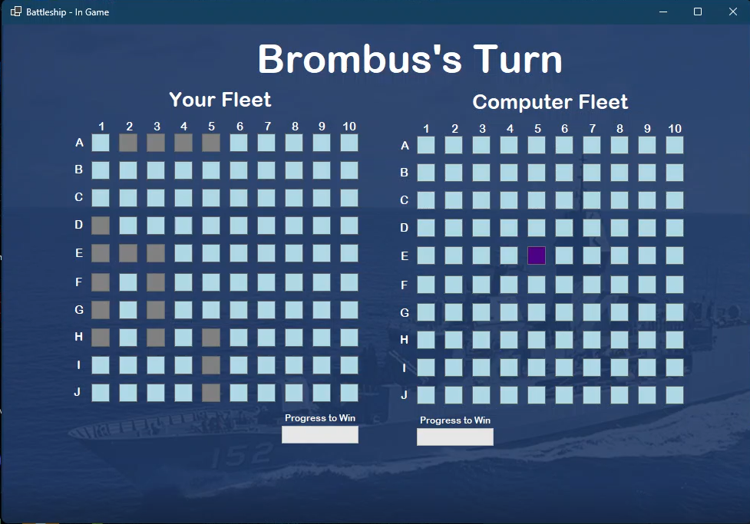

Slide 14
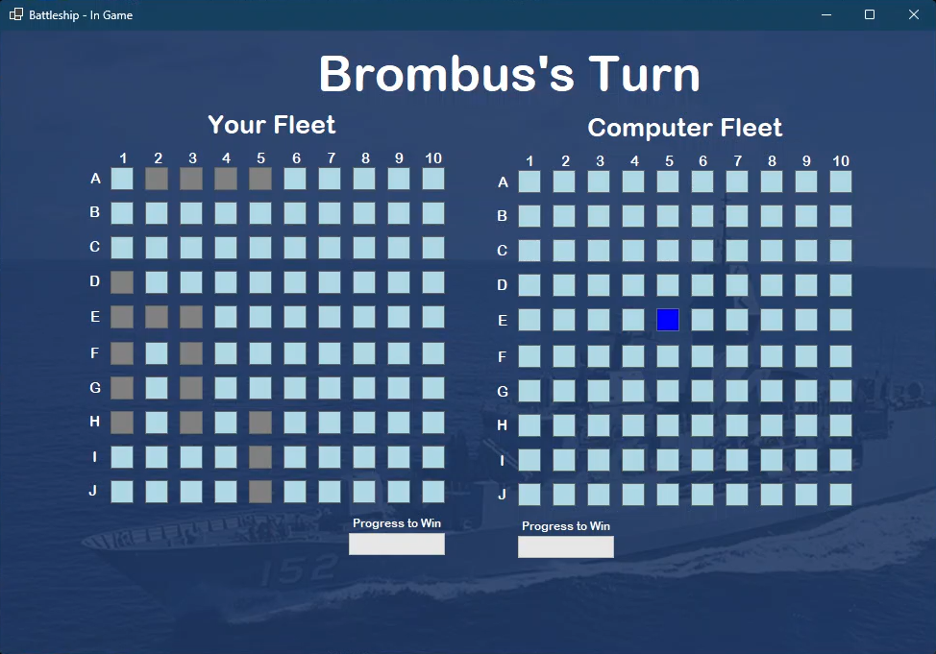

Slide 15
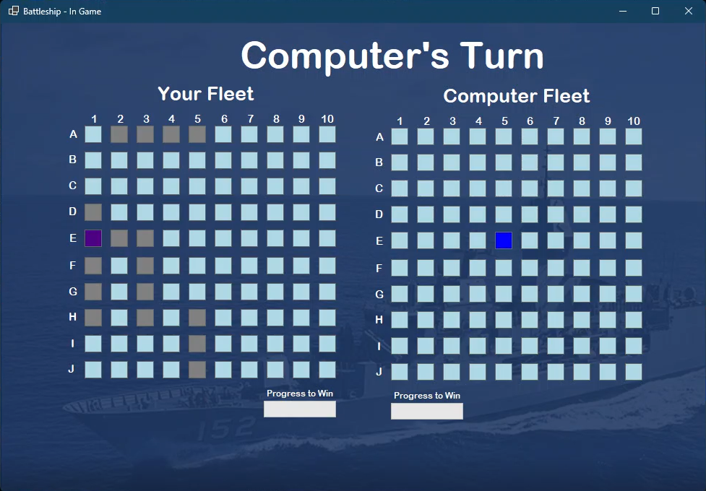

Slide 16


Slide 19
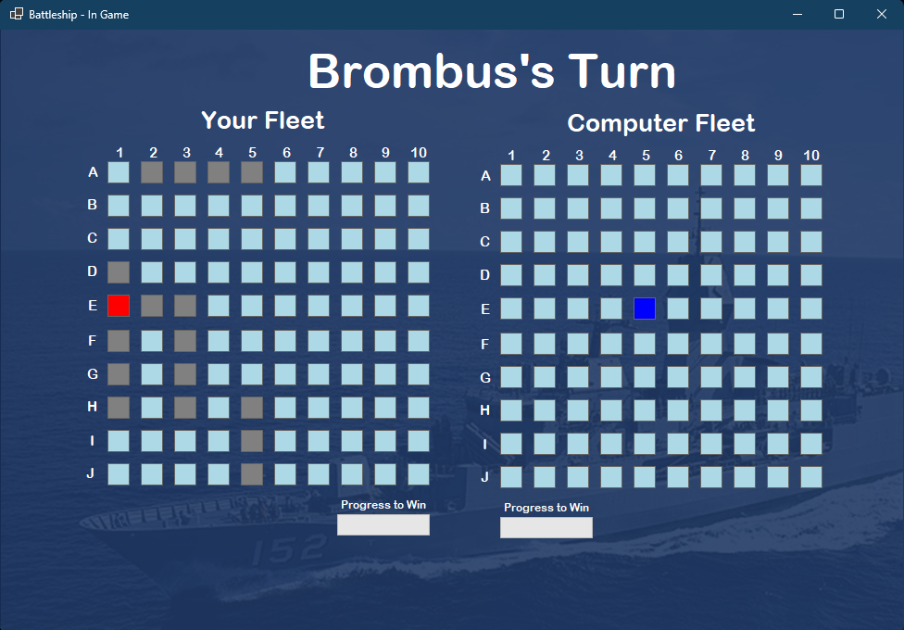

Slide 20
The computer made a hit!
We made a miss.
Let’s fast-forward the game now to look at sinking a ship
Click here to continue

Slide 21
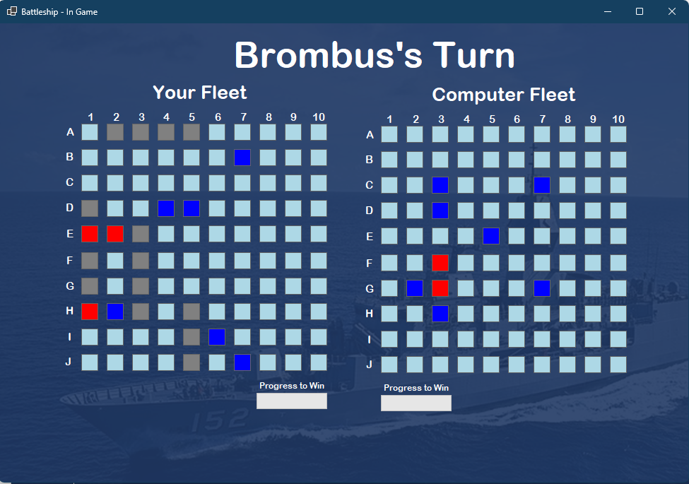
We are super close to sinking a ship
Click E3 to sink a ship

Slide 22
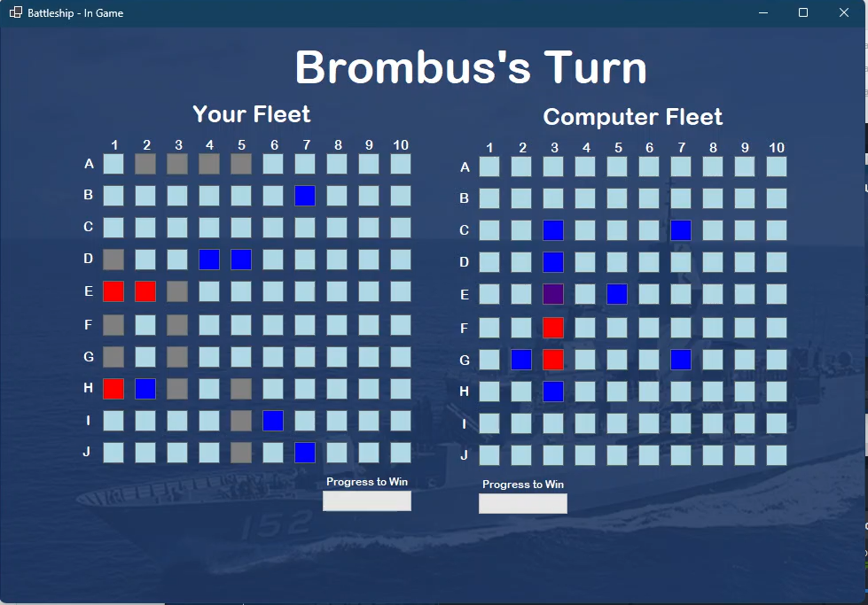

Slide 23
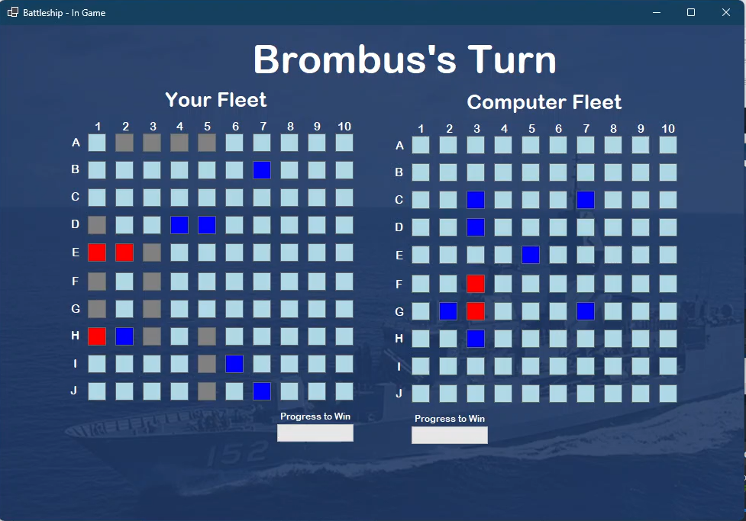

Slide 26
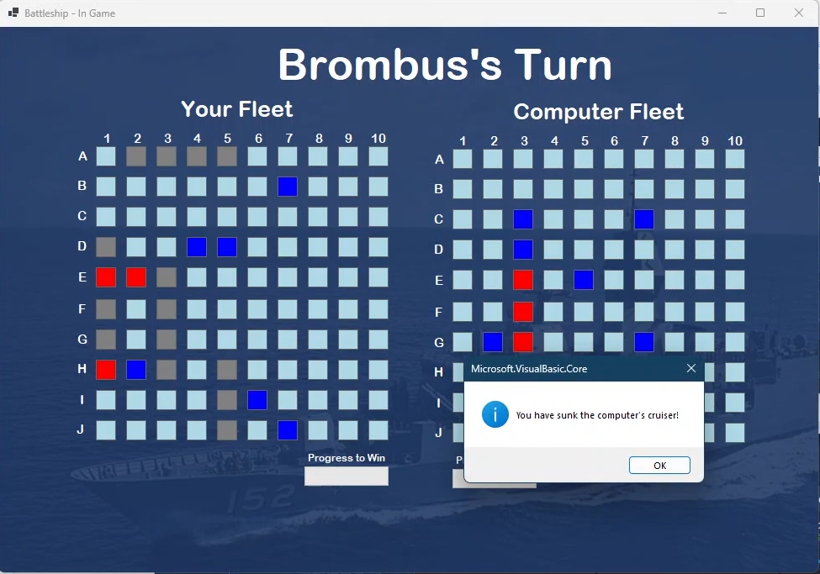
Nice! We’ve sunk the ship
Let’s take a look at this box.
Click it to continue

Slide 27
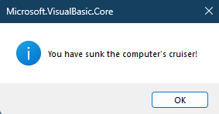
We’ve sunk the Cruiser!
The Cruiser is one of 5 ships the opponent is hiding.
When you’re ready to go back to the board, Click OK

Slide 28
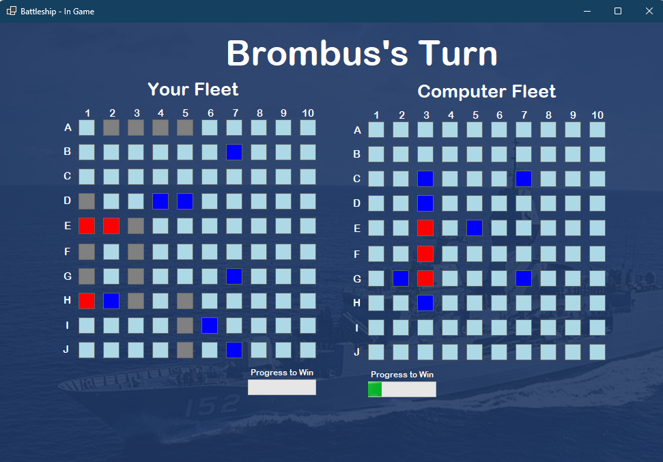
This will display your progress sinking the ships. It will update when you sink one
Your Vice-Admiral will take it from here.
Click here to finish the game.

Slide 29
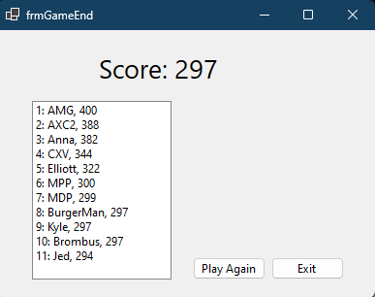
1. This is our score. It’s put us on the leaderboard!
4. When you are ready, exit the tutorial
2. We are tied on the scoreboard with BurgerMan and Kyle. That’s great for a first go
3. You can do the tutorial again by clicking here

